Slide 1
The Competitive Effects of
Ownership of Financial Transmission Rights in a Deregulated Electricity Industry
Manho Joung
and Ross Baldick
Electrical and Computer Engineering Department

Slide 2

Agenda
Background
Market Model
Problem Formulation
Analysis and Results
Numerical Example
Conclusions

Slide 3

Transmission Line Congestion
A transmission line is “congested” when the capacity constraint is active.
Under locational marginal pricing (LMP), locational price differences occur when there is congestion.
Congestion causes transmission price risk for market participants.

Slide 4


Market Implication of Congestion
$1/MWh
$2/MWh
Gen
Demand
Line capacity K
Generator sells electric power to demand located at another bus.
Congestion risk:
  When congestion occurs the LMPs differ:
    Generator sells electric power at $1/MWh.
    Demand buys electric power at $2/MWh.
  Bilateral energy contract between generator and demand does not hedge transmission price risk.

Slide 5


Transmission Rights
Introduced for hedging congestion risk.
Two types of transmission rights:
  Physical transmission rights:
    Exclusive right to transport a predefined quantity of electricity between two locations,
    Inefficient dispatch due to right holder withholding.*
  Financial transmission rights (FTRs):
    No exclusive right to use the transmission network,
    No physical withholding.
* Joskow and Tirole, “Transmission rights and market power on electric power networks,” RAND Journal of Economics, 2000 and Lyons, Fraser, and Parmesano, “An Introduction to Financial Transmission Rights,”
The Electricity Journal, 2000.

Slide 6

FTR Direction
“Sourcing” direction is from generator bus to another bus.
“Sinking” direction is from another bus to generator bus.
Right Holder
Sourcing Direction
Gen
Network
Sinking Direction

Slide 7

Financial Transmission Rights (FTRs)
Two types of FTRs:
  “Options:” only positive payoff, independent of relationship between prices P₁ and P₂.
  “Obligations:” either positive or negative payoff, depending on relationship between prices P₁ and P₂.
P₁ $/MWh
P₂ $ /MWh
Gen
Load
Right Holder

Slide 8
FTR Models
Reference model:
  No FTRs considered, same set-up as Borenstein, Bushnell, and Stoft (BBS).
FTR option model:
  amount of right owned is specified by η,
  only positive payoff.
FTR obligation model:
  amount of right owned is specified by γ,
  either positive or negative payoff.
η and γ specify the fraction of the total available FTRs.
Total available FTRs assumed equal to line capacity K.

Slide 9

Flow from 1 to 2 at limit and P₁ < P₂
P₁ $/MWh
K MW
P₂ $/MWh
Gen
Load
Line capacity K
Right Holder
P₁< P₂
Reference model: no FTR payoffs.
Payoffs for FTR option model with fraction η:
  FTR in sourcing direction: (P₂ – P₁) ·η ·K > 0,
  FTR in sinking direction: 0.
Payoffs for FTR obligation model with fraction γ:
  FTR in sourcing direction: (P₂ – P₁) · γ · K > 0,
  FTR in sinking direction: (P₁ – P₂) · γ · K < 0.

Slide 10
Flow from 2 to 1 at limit and P₁ > P₂
P₁ $/MWh
K MW
P₂ $/MWh
Gen
Load
Line capacity K
Right Holder
P₁> P₂
Reference model: no FTR payoffs.
Payoffs for FTR option model with fraction η:
  FTR in sourcing direction: 0,
  FTR in sinking direction: (P₁ – P₂) ·η ·K > 0.
Payoffs for FTR obligation model with fraction γ:
  FTR in sourcing direction: (P₂ – P₁) · γ · K < 0,
  FTR in sinking direction: (P₁ – P₂) · γ · K > 0.

Slide 11
Market Model & Formulation
Load
Load
Gen
Gen
Line capacity K
Market i
Market j
Inverse affine demand curves with a constant negative slope.
Quadratic costs for generators.
Two types of FTR ownership considered.
Cournot assumption:
  Generators aim to maximize their profits by determining their electricity production quantity.

Slide 12


Analysis Design
This problem is a game.
  Each generator’s profit is a function of his generation quantity determination as well as of the opponent’s quantity determination.
Equilibrium analysis based on game theory
  Solution concept: Nash equilibrium
  Best response curve analysis
Consider solution of “single-shot” equilibrium for various levels of demand.

Slide 13
Best Response Curve
A curve representing the relationship between the best (highest payoff) strategy by a player and the strategy of its rival.
Cournot context:
A curve representing the relationship between the best (highest profit) electricity production quantity by a generator and the quantity of the other generator.

Slide 14
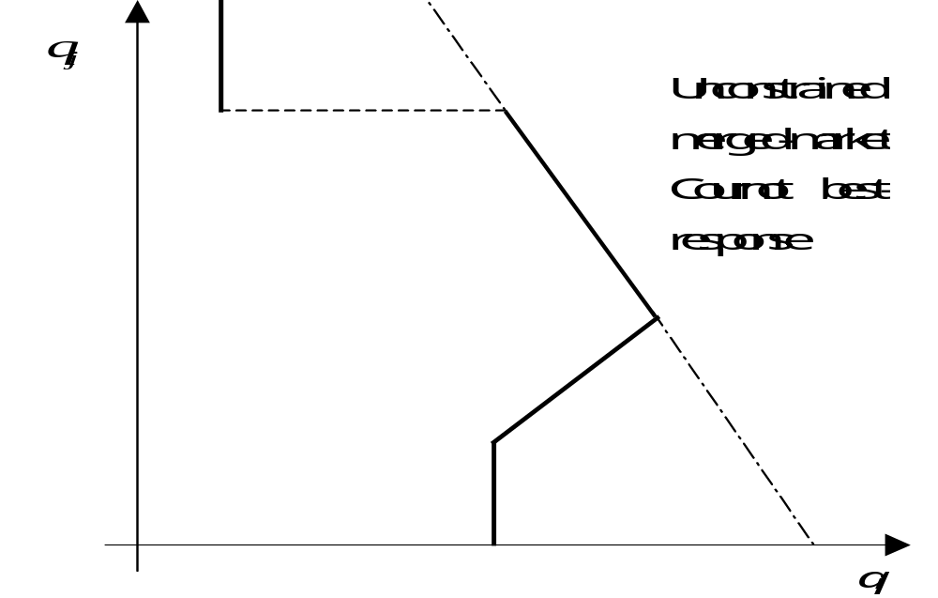
Best Response Curve Illustration
Generator
j’s quantity
With No Congestion
With Congestion
Generator i’s quantity
Generator i’s Best Response Curve

Slide 15
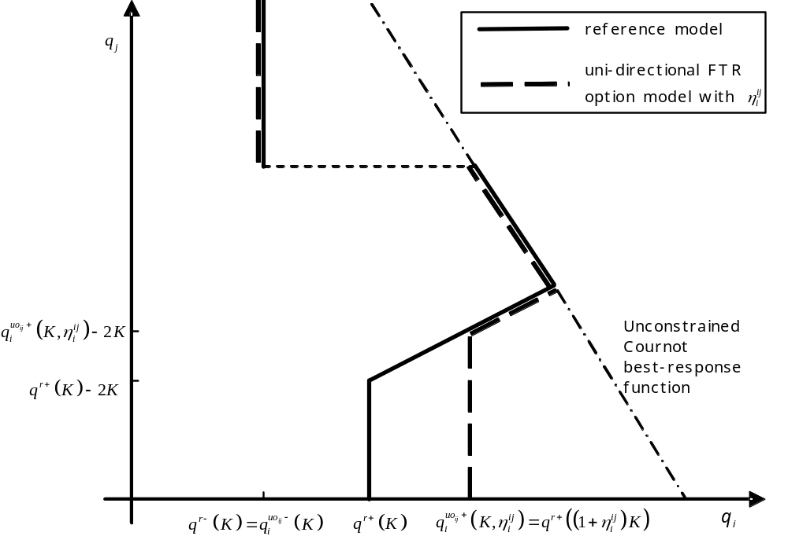
Best Response Curves
FTR Option Model vs. Reference Model
Sourcing Direction

Slide 16
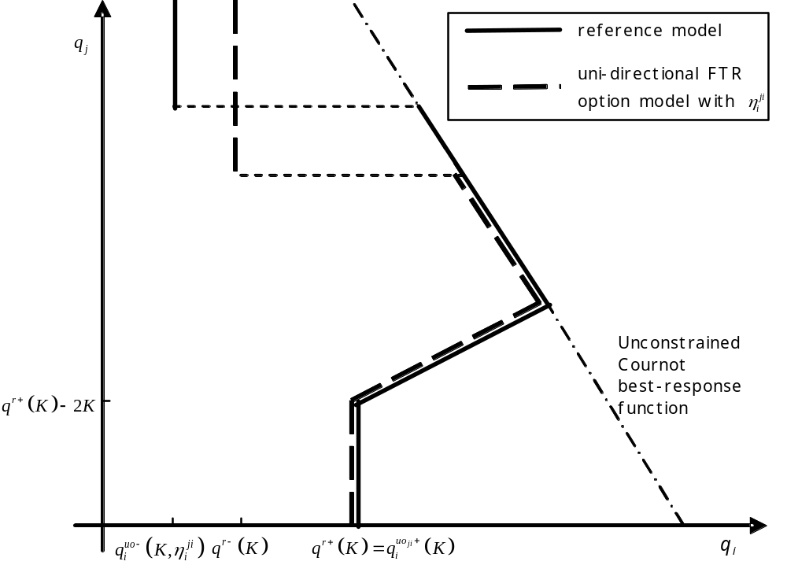
Best Response Curves
FTR Option Model vs. Reference Model
Sinking Direction

Slide 17
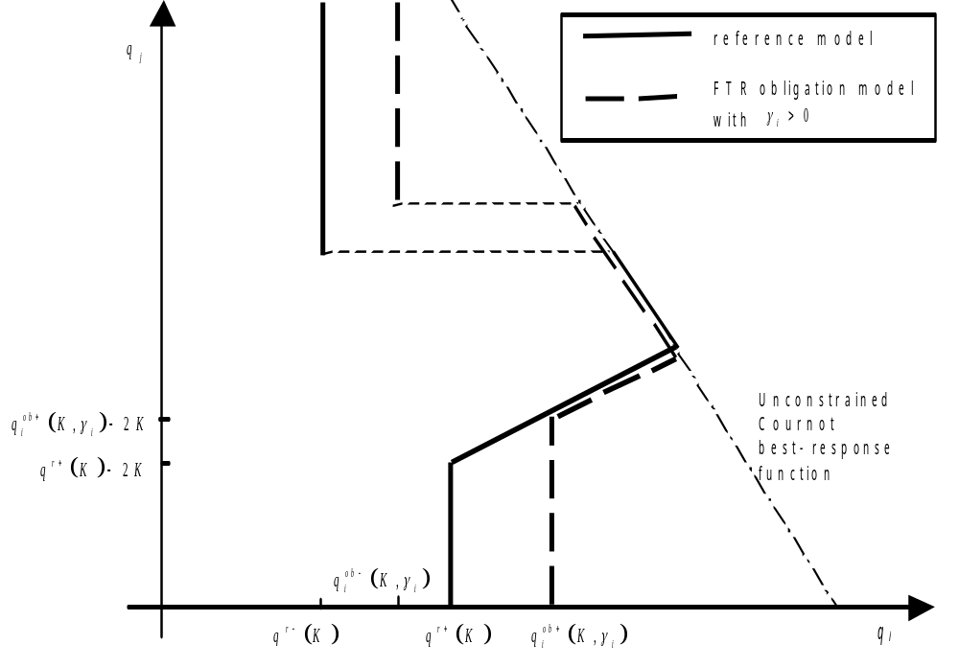
Best Response Curves
FTR Obligation Model vs. Reference Model
Sourcing Direction

Slide 18
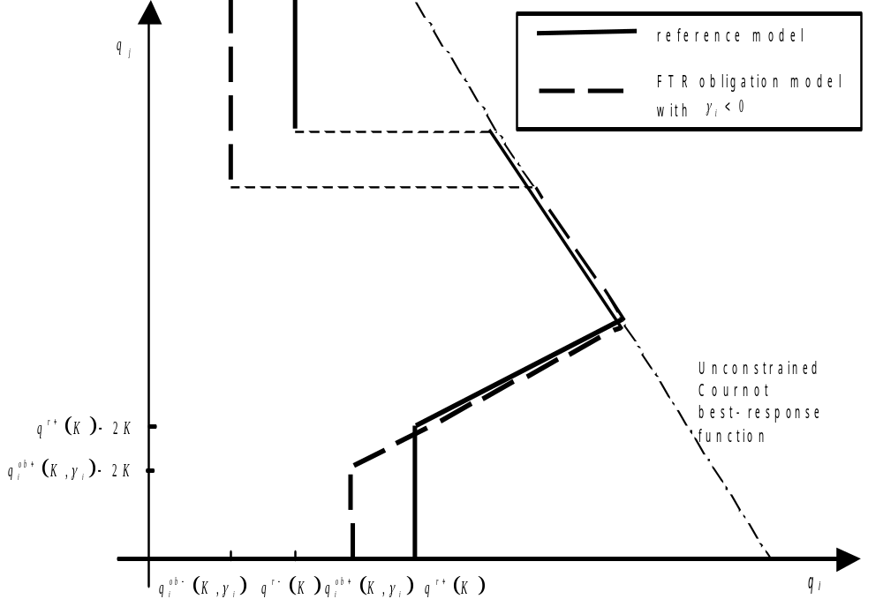
Best Response Curves
FTR Obligation Model vs. Reference Model
Sinking Direction

Slide 19
Solution Method
Nash equilibrium solution concept.
Intersection of the two best response curves is the Nash equilibrium.
Two types of (pure strategy) equilibrium:
  Unconstrained Cournot equilibrium (with no congestion), and
  Passive/aggressive equilibrium (with congestion).

Slide 20
Evaluation of effect of FTRs
Unconstrained merged-market Cournot equilibrium is more competitive than passive/aggressive equilibrium:
  Competitive effect of FTR is “good” if it increases the range of demand for which the merged-market Cournot equilibrium occurs, makes the merged-market Cournot equilibrium more likely to occur,
  Competitive effect of FTR is “bad” if it decreases the range of demand for which the merged-market Cournot equilibrium occurs.

Slide 21
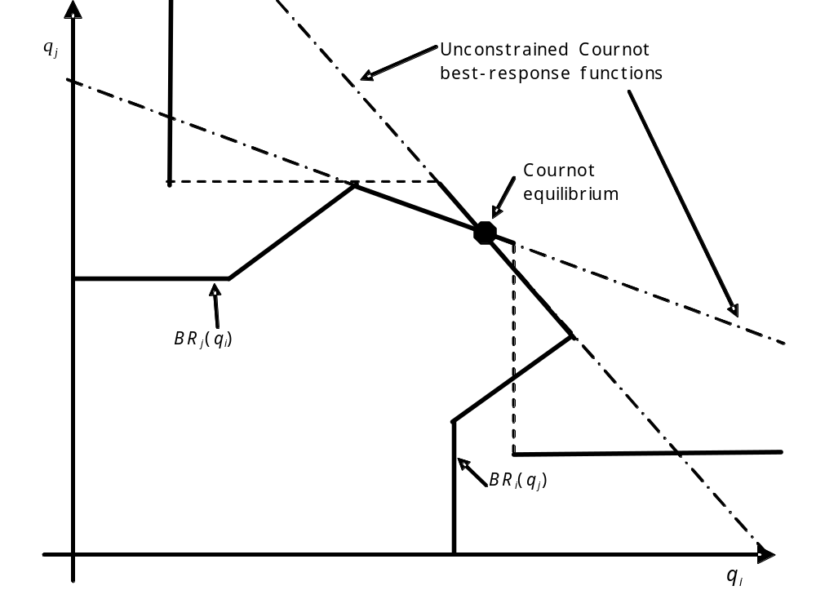
BRC Analysis Example 1, without FTR
Reference Model
Unconstrained merged-market Cournot equilibrium without congestion

Slide 22
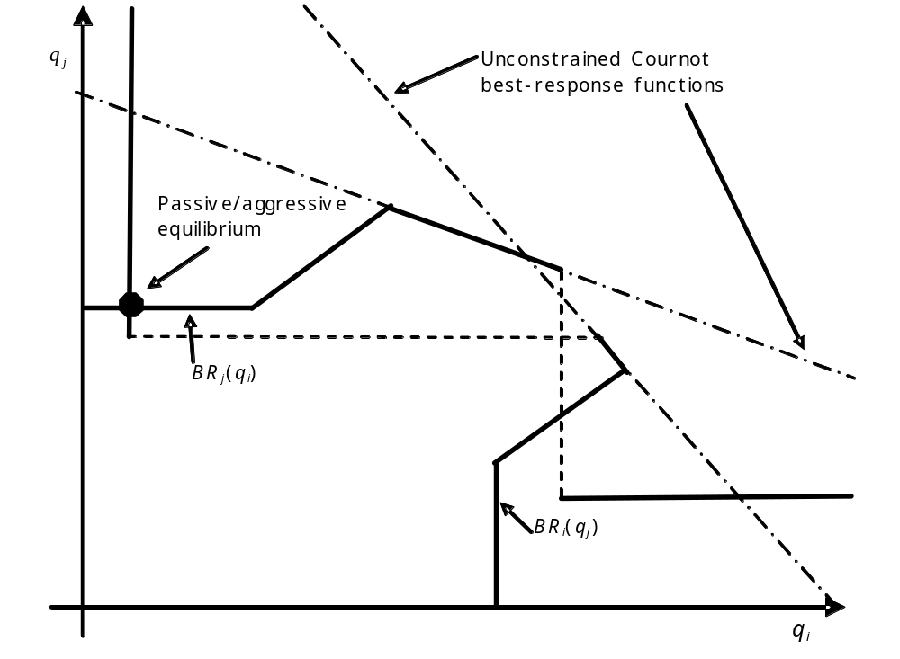
BRC Analysis Example 1, with FTR
FTR Option Model (sinking direction)
Passive/aggressive equilibrium with congestion

Slide 23
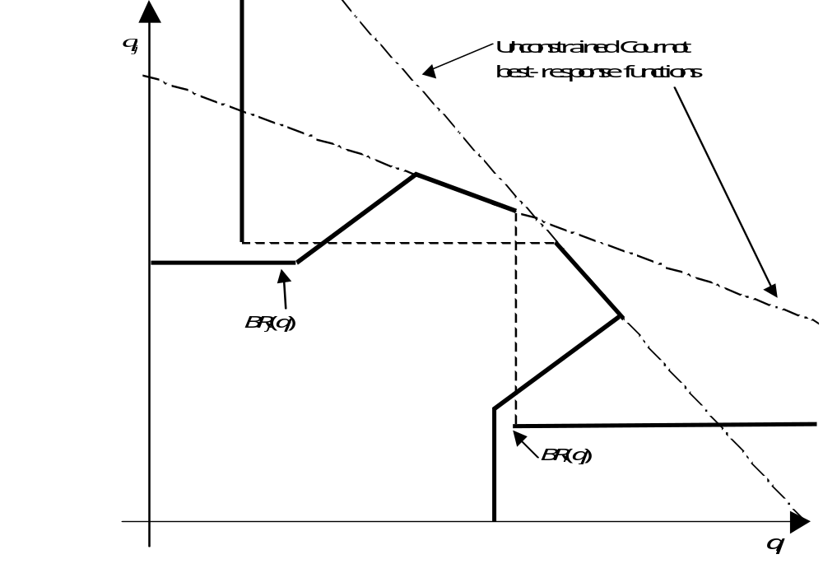
BRC Analysis Example 2, without FTR
Reference Model
No pure strategy equilibrium

Slide 24
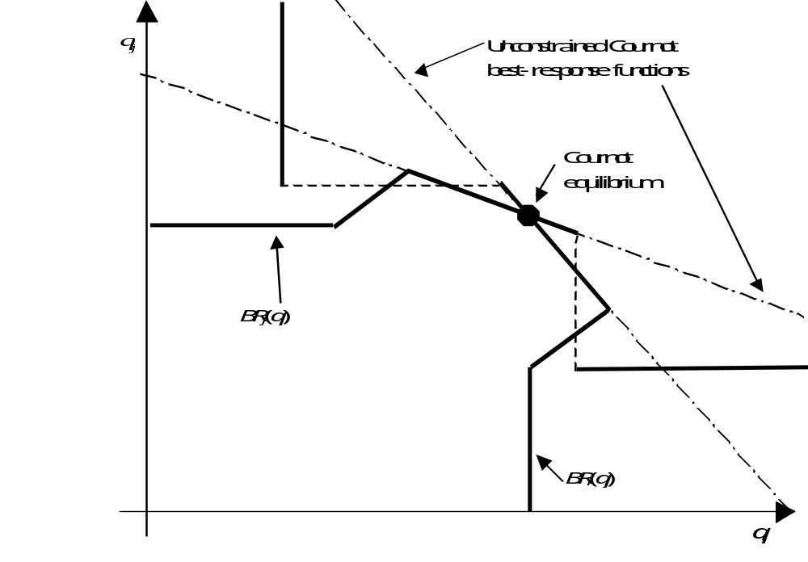
BRC Analysis Example 2, with FTR
FTR Obligation Model (sourcing direction)
Unconstrained merged-market Cournot equilibrium without congestion

Slide 25
Analysis Summary
FTR options in the sourcing direction:
  no effect on achieving the unconstrained merged-market Cournot equilibrium.
FTR options in the sinking direction:
  make the unconstrained merged-market Cournot equilibrium less likely to be achieved.
FTR obligations in the sourcing direction:
  make the unconstrained merged-market Cournot equilibrium more likely to be achieved.
FTR obligations in the sinking direction:
  make the unconstrained merged-market Cournot equilibrium less likely to be achieved.

Slide 26
Competitive Effects for Each FTR Model
 | Sinking direction | Sourcing direction
FTR option | B | N
FTR obligation | B | G
(B: bad effect, G: good effect, N: no effect)

Slide 27
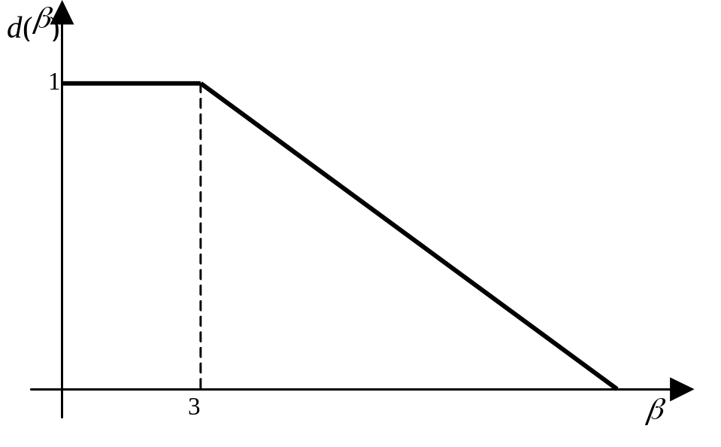
Numerical Example
Two market model.
Inverse affine demand curves with a negative slope for load:
  Varying intercept represented by an inverse-demand duration curve.
  Assume perfect correlation between intercepts of two inverse demand curves.
β: intercept of
inverse demand curve

Slide 28
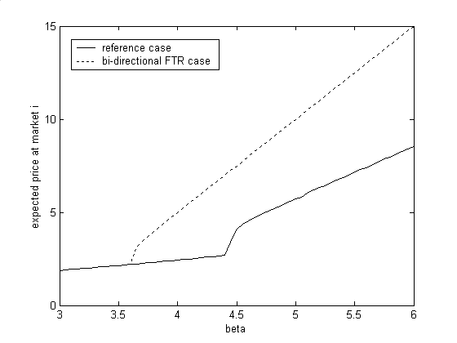
Numerical Results
Importing Market Price
FTR option ownership of importing market generator in sinking direction

Slide 29
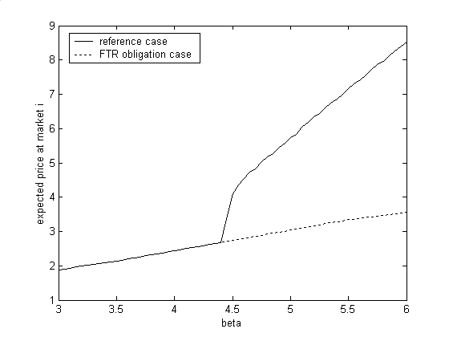
Numerical Results
Importing Market Price
FTR obligation ownership of importing market generator in sourcing direction

Slide 30
Conclusions
Competitive effects of ownership of two different types of FTRs are assessed.
By introducing FTRs in an appropriate manner, the physical capacity needed for the full benefits of merged-market competition can be reduced:
  Generator owning FTRs in sourcing direction.
Conversely, FTR ownership can worsen market power:
  Generator owning FTRs in sinking direction.

